Slide 1
REPowerEU – financial opportunities for research and innovation
EU ETS Innovation Fund
Ewelina Daniel, DG Climate Action 12 May 2023

Slide 2
Outline of presenation
Innovation Fund in a nutshell
Political context
Large- and small-scale calls for proposals
Auctions
Next steps

Slide 3
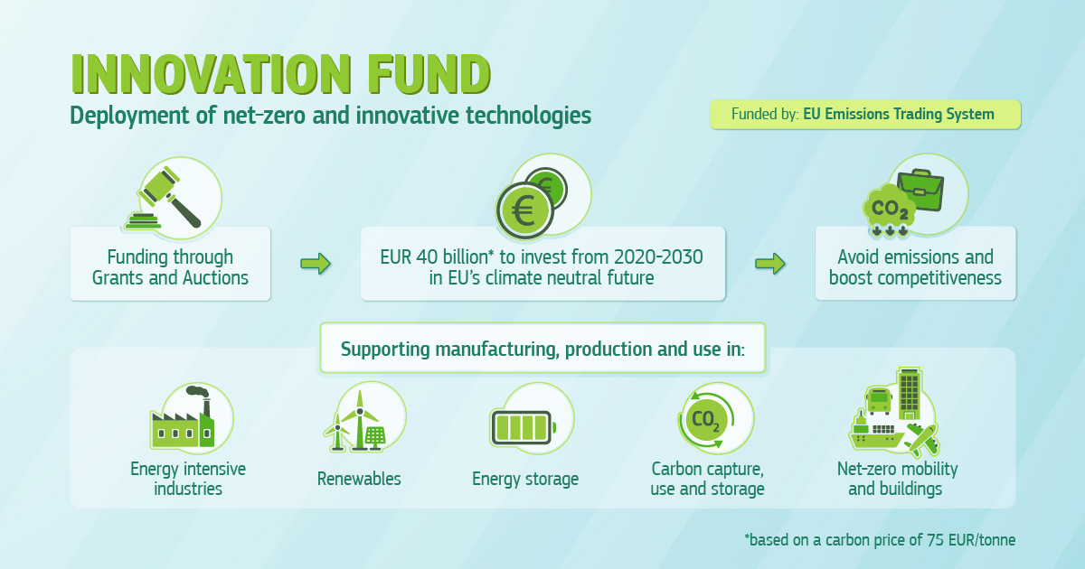

Slide 4
Innovation Fund – targeted project portfolio
Technology Readiness Level
Horizon Europe
European Innovation Council
Research and Innovation
Early adoption, start-ups
LIFE programme
Pilot projects for mitigation and adaptation
Innovation Fund
GRANTS: upscaling to commercial level
Debt financing
Connecting Europe Facility
InvestEU – EIB
Transport facilities for energy and mobility
Auctions: roll-out of mature technologies
Modernisation Fund
RE, EE, energy storage, energy networks for 10 lower-income countries
1 2 3 4 5 6 7 8 9
1 2 3 4 5 6
Commercial readiness level
National funding (including RRPs)
TRL & CRL are indicative
Notes:
The Innovation Fund is a unique programme on the EU funding landscape as it supports key stages of technological development: from large-scale demonstration to upscaling and roll out of innovative technologies. It does this in complementarity and in synergy with all other EU programmes you see on the slide – Horizon Europe, Modernisation Fund, Connecting Europe Facility, Life programme, Invest EU, Recovery and Resilience Facility.
In terms of technology development, the Innovation Fund grant programme aims to bridge the gap between the pilot/demo phases of a technology and its actual commercialisation. This gap, also called ‘valley of death’ was not appropriately addressed by the EU funding before the Innovation Fund.
Later technology roll-out can also be funded and it will be targeted by the auctions under development under the Innovation Fund.
However, the impact of the programme is dependant on its size. This is why, we are working with the MS to help them identify and fund Innovation Fund projects on their territory. We will talk about this later during the detailed presentations.

Slide 5
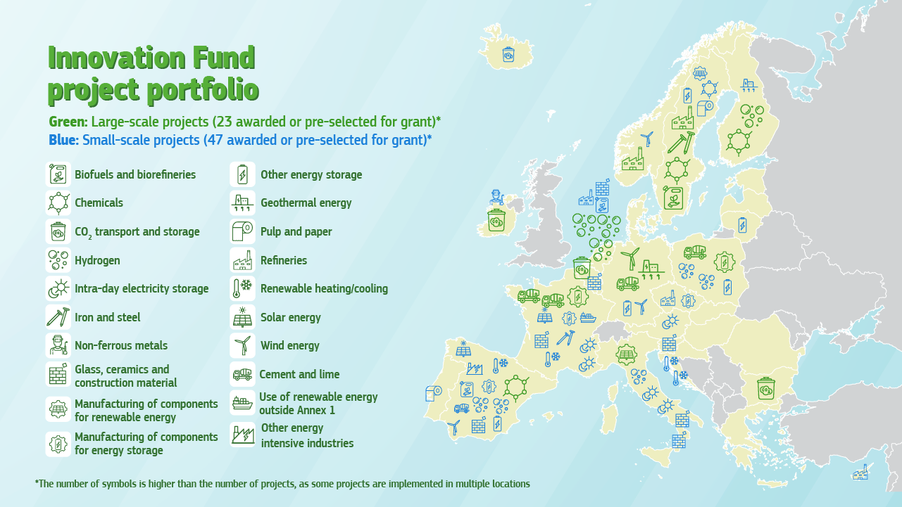
Innovation Fund results in a glance

Slide 6




Key changes to the Innovation Fund following the ETS Directive revision
Revised ETS Directive includes changes on:
  The overall size of the Innovation Fund increase from 450 million ETS allowances to ca. 530 million ETS allowances.
  Scope changes: new sectors (e.g. Maritime); medium scale projects; DNSH from 2025; stronger reference to multiple environmental impacts
  The introduction of new financial instruments under the Fund (“Competitive Bidding”): Fixed premium, Contracts for Difference (CfDs) or Carbon Contracts for Difference (CCfDs), covering up to 100% of the funding gap
  Stronger attention to geographical balance

Slide 7
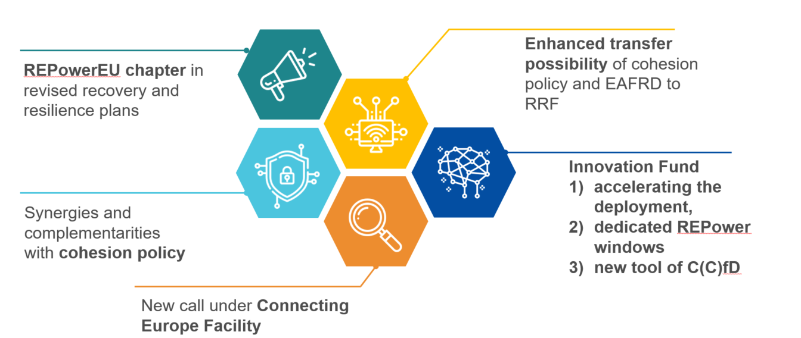
RePowerEU Plan
REPowerEU Plan:
“To support hydrogen uptake and electrification in industrial sectors, the Commission will roll out carbon contracts for difference and dedicated REPowerEU windows under the Innovation Fund to support a full switch of the existing hydrogen production in industrial processes from natural gas to renewables and the transition to hydrogen-based production processes in new industrial sectors, such as steel production”

Slide 8
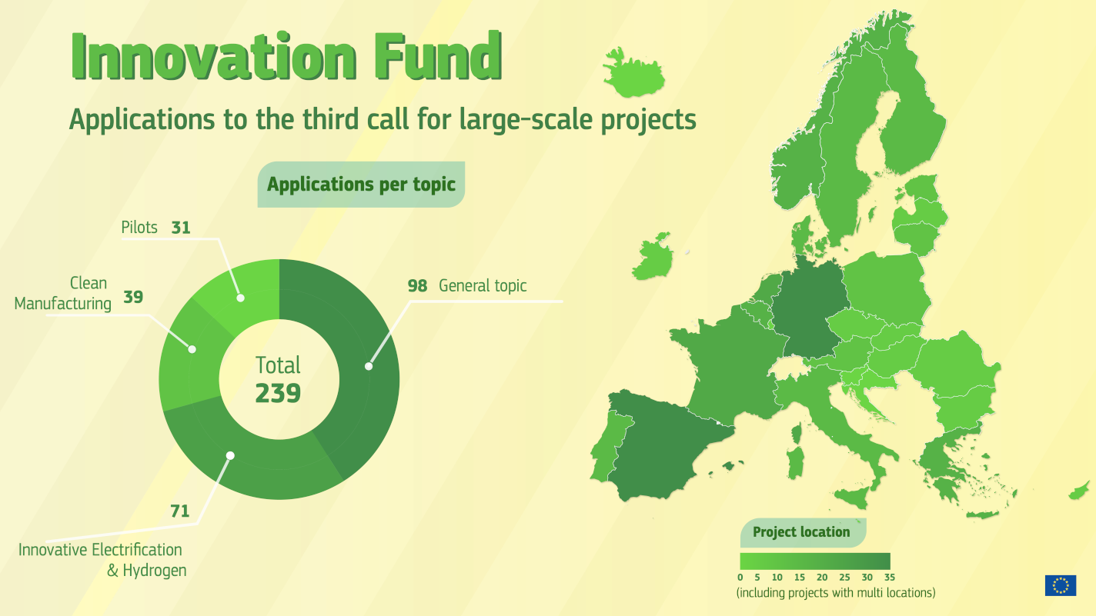
Closure of 3LSC: First results
Closed on 16 March 2023
6X oversubscription with total funding requested EUR 18 billion
Applicants will be informed about the results mid-July 2023

Slide 9



2022 small-scale call for projects: key features
Launch 30 March 2023
Deadline 19 Sept. 2023
Results Q4 2023
AWARD CRITERIA
Degree of innovation
GHG emission avoidance*
Project maturity
Scalability
Cost efficiency
*incl. quality of calculations, net carbon removals and other GHG emission savings (bonus point)
€ 100 Million for grants
+
Project Development Assistance
GRANT DISTRIBUTION
LUMP-SUM contribution
grant up to 60% of relevant costs
up to 40% of grant at financial close
remaining amount of at least 60% after financial close
generally, at least 10% after Entry into operation.
Call text

Slide 10
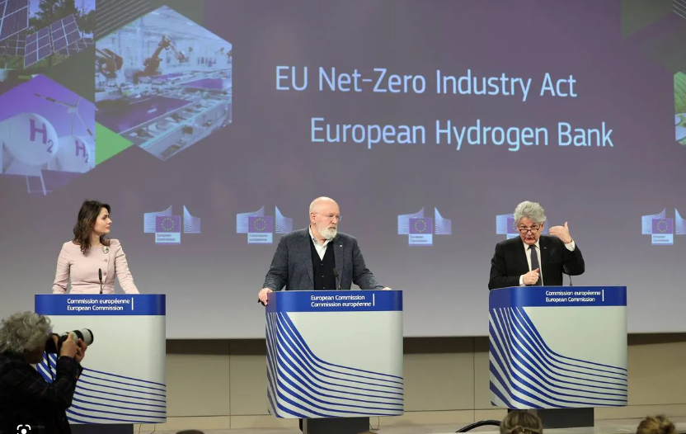
European Hydrogen Bank
Announcement in the State of the Energy Union in 2022 – link with RePowerEU objective of 20 Mt of renewable hydrogen
European Hydrogen Bank communication adopted on 16 March 2023 together with Net Zero Industry Act
EHB presents the structure of the initiative and key modalities of the first pilot auction for renewable hydrogen – to be financed by the Innovation Fund
Timing confirmed of pilot domestic auction: autumn 2023
Stakeholders consultation on pilot domestic auction

Slide 11




Market-based instrument with a lean procedure
1
2
3
4
5
SUBMIT
1
2
3
CLIMA prepares & publishes an
auction call
Bidders submit prequal. material and bids
Bidders’ prequal. materials are checked and bids are ranked by CINEA
Auction is cleared
Bids awarded by CINEA until budget cap is reached
6
7
8
9
10
11
1
+ -
H₂
H₂
H₂
Bid award decisions shared with winners & unsuccessful bidders
Auction outcomes are published publicly
Winners sign fixed premium agreement with CINEA
Project realization and construction
Winners get fixed premium IF support based on the contract
Penalties executed
in case of delayed realization

Slide 12
2023 pilot auctio
Final Consultation
currently being finalised
Fixed-premium auction
Budget: EUR 800mn
Auctioned good: Renewable Hydrogen
Support in form of a fixed premium in EUR/kg of renewable hydrogen produced, over 10 years
Bids ranked on price – budget allocated to the projects with the lowest specific support requirements
Pay-as-bid
Output based support (upon verified and certified production of volumes), no payments before entry into operation
Maximum realisation period (time to entry into operation) of 3.5 years, can be prolonged to 4 years under penalty
No cumulation with other public funding
OPEX
Need for subsidy: premium sought in the auctions
€‎/kg H₂
LCOH
hydrogen sales revenue, including green premium
CAPEX
Bids ranked on price
Clearing price
Non-awarded
bids
€‎/kg H₂
Awarded
bids
Kg H2

Slide 13
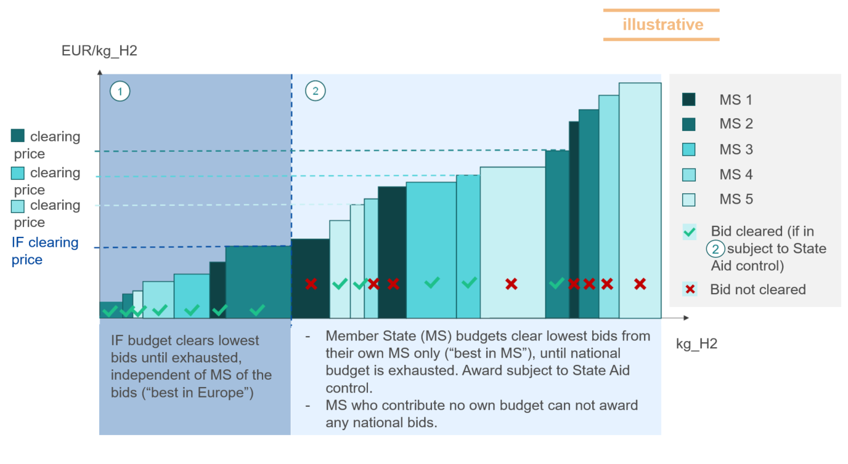
Look into the future: potential to expand auctions beyond hydrogen sector, and as a service for Member States
H2 Strategy communication proposes to offer an EU-wide auction mechanism through “auctions-as-a-service”.
Member States can clear projects that are outside of the IF budget.
Less market fragmentation, less administrative cost
Work with DG COMP as national schemes subject to State Aid rules.
Auctions concept – if successful – could be extended to other sectors, such as clean-tech manufacturing and industry decarbonisation.

Slide 14
Implementation Timeline 2023
Auctions
Grants
30 March 3rd call for small scale projects opens
31 March Publication of auctions’ T&C for stakeholders’ feedback
20 April Info Day 3rd call for small scale projects
16 May Workshop on stakeholder feedback on pilot auctions’ T&C
26 May Workshop with Member States on “auctions as a service”
13 June Workshop on next calls and auctions
4 July Workshop on Small Scale Call for proposals
July Results of 3 LSC evaluation
Early September Auctions - Final Terms and Conditions published
19 September Deadline 3rd small-scale call
December First pilot auction launched
TBC 4th Calls for proposals for grants launched

Slide 15






Where to find more information?
All (past) call documents available on the Funding and Tenders Portal including:
Further info, planning of new calls, recorded webinars and videos available on the IF Website:
Guidance and calculation tools on GHG emissions and relevant costs
Frequently asked questions
https://europa.eu/!rx34Dt
https://europa.eu/!QB67by
Innovation Fund - YouTube
https://bit.ly/2WxK8w7

